Slide 1
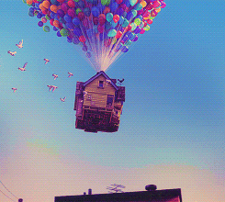
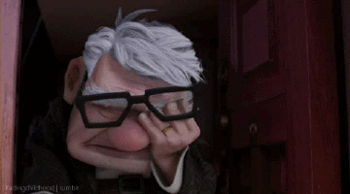
Where’s my house?

Slide 2
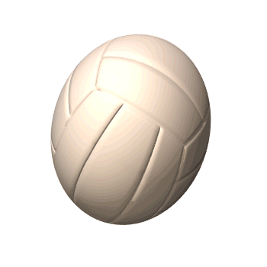
ball
a baseball
a pokéball
a basketball
a soccer ball
a volleyball

Slide 3
box
a candy box
a mail box
a gift box

Slide 4
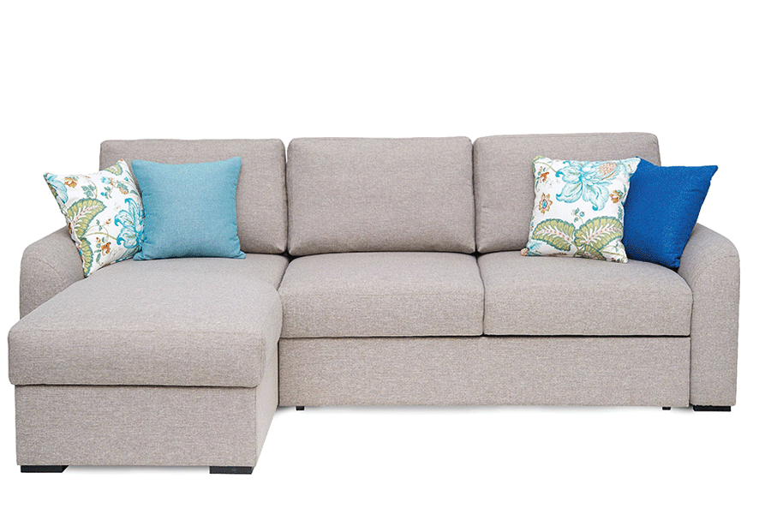
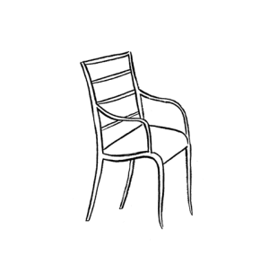
chair
a sofa
a bench

Slide 5
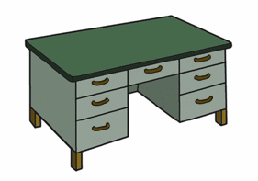
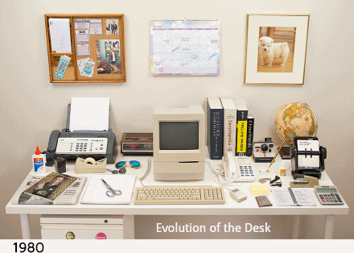
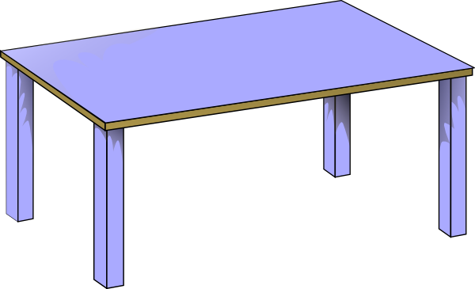
desk
a desk
a table

Slide 6
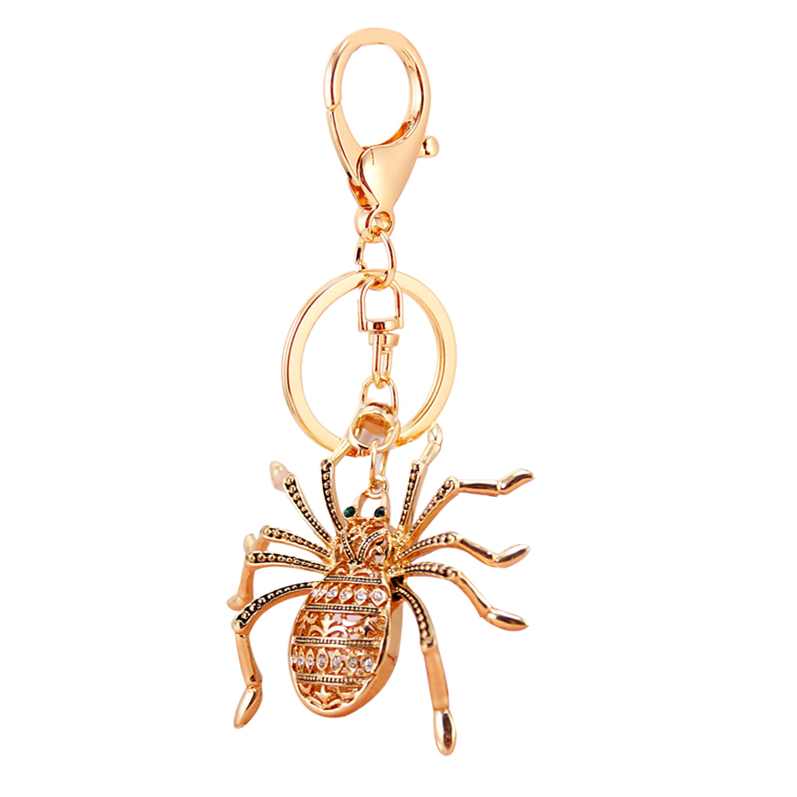
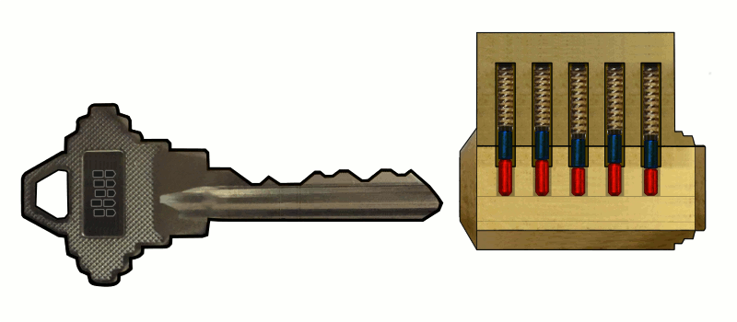
key
We can use the key to lock.
a key ring

Slide 7
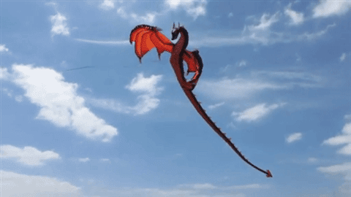
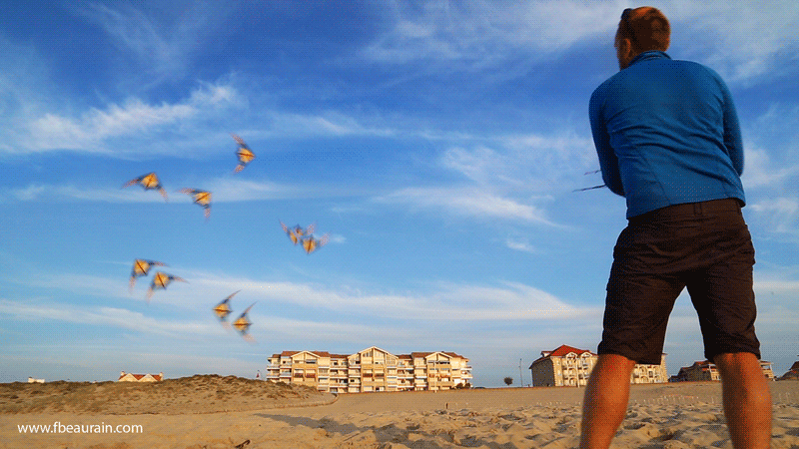
kite
fly a kite

Slide 8
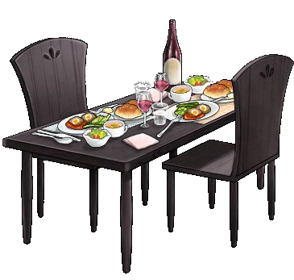
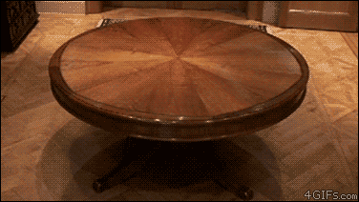
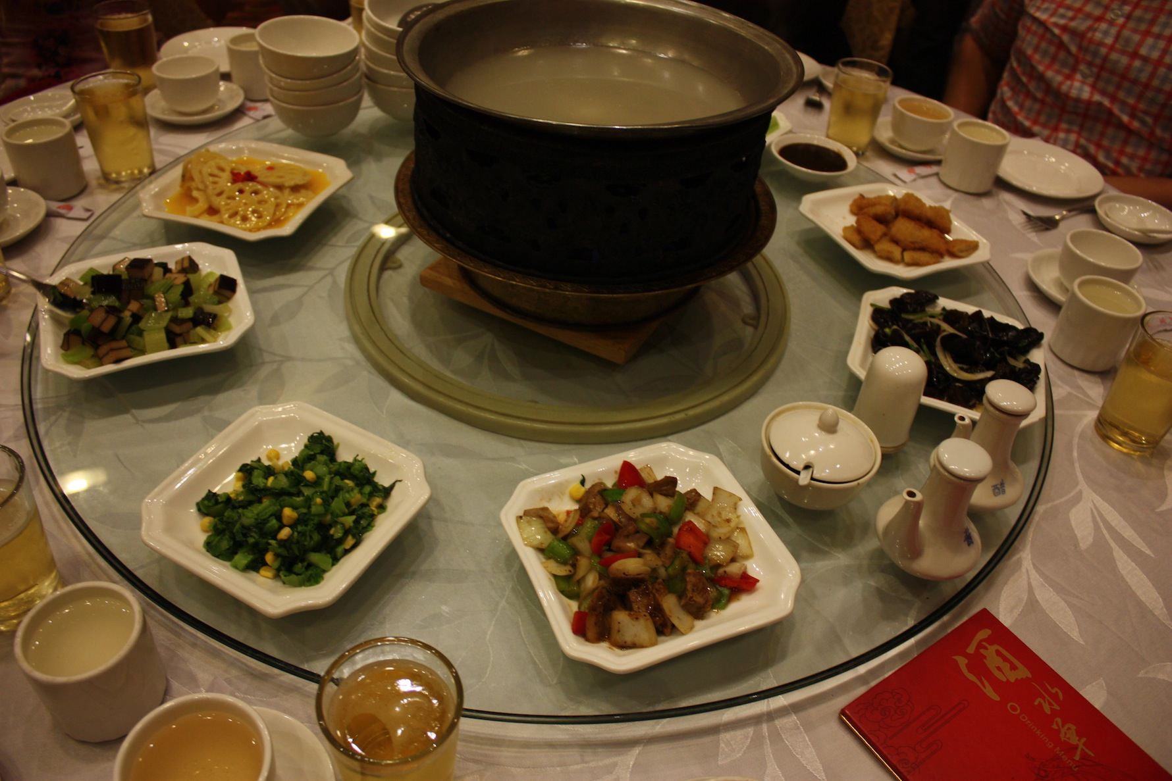
table
dining table
lazy Susan

Slide 9
a box
a ball
chairs
a key
a table
a kite
a desk

Slide 10
Where is the Pikachu?
It’s in the box.

Slide 11
Where is the man?
He’s on the ball.

Slide 12
Where are the eggs?
They’re under the penguins.

Slide 13
Where is Belle?
She’s next to the bad guy.

Slide 14
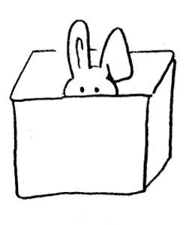
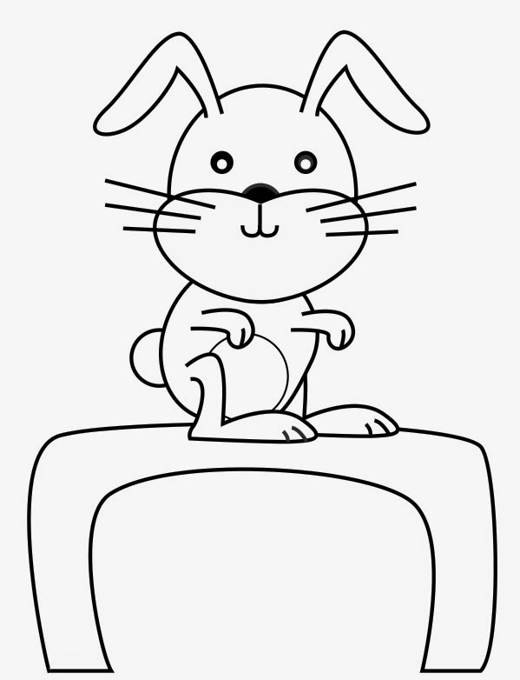
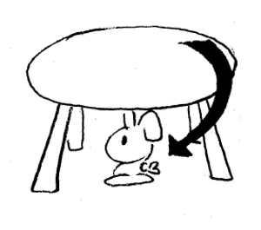
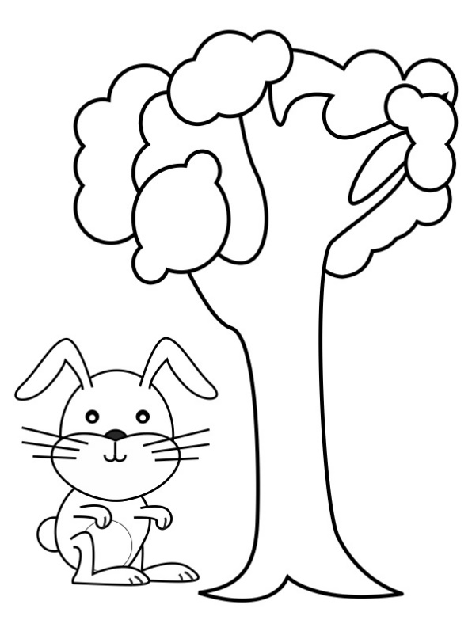
preposition
in on under next to
Mandy Says……

Slide 15
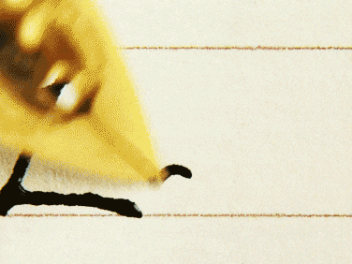
Challenge Time!!!!!

Slide 16
The pony is ______ the desk.

Slide 17
The cat is ______ the rabbit.

Slide 18
They are ______ the car.

Slide 19
The cow is ______ the car.

Slide 20
The baby is ______ the box.

Slide 21
The worms are ______ the stone.

Slide 22
The spider is _____ the roof.

Slide 23
The pigs are ______ the tiger.

Slide 24
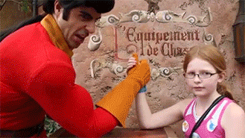
Harder Challenge!!!!!

Slide 25
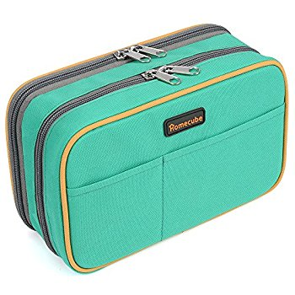
Prepare these things……

Slide 26
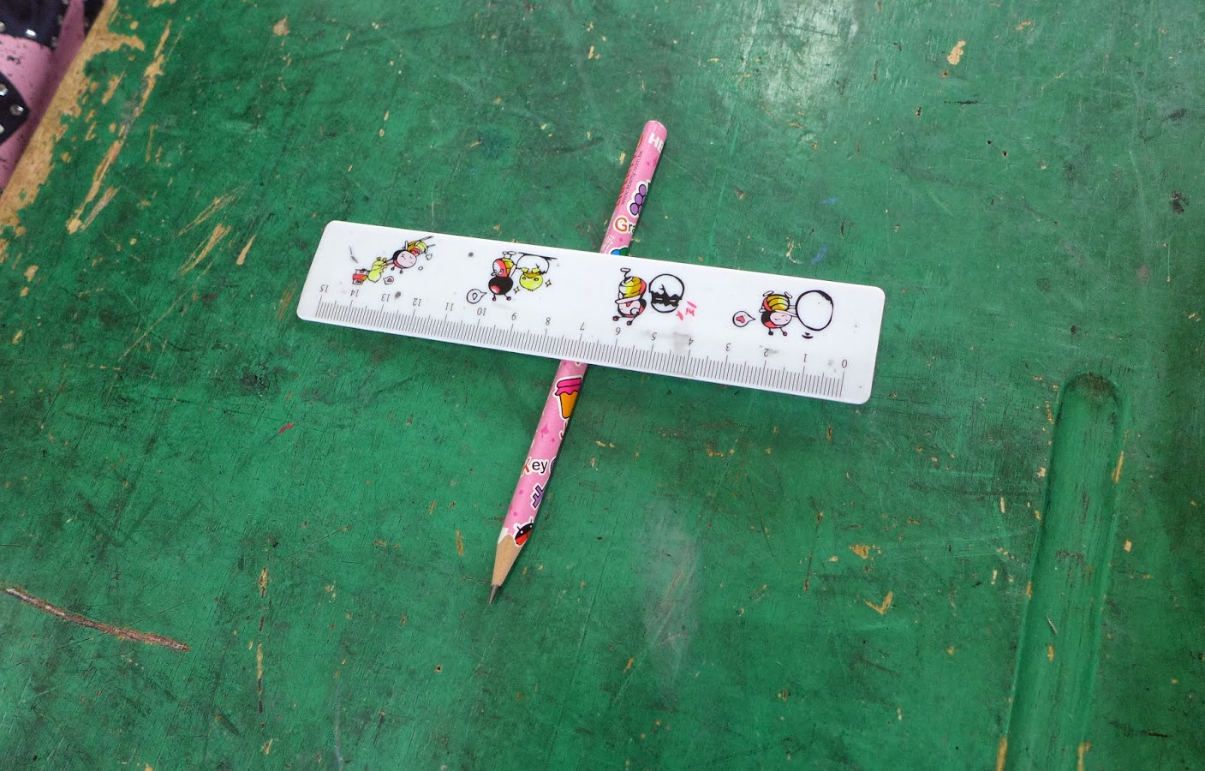
1. Clear your desk. 2. Put all things into the drawer. 3. After the instructions, you can put the things on the desk.

Slide 27
Make your own book!!
Where is ______?
He/She/It is _____ the _______.
Where are ________?
They are _____ the _______.

Slide 28
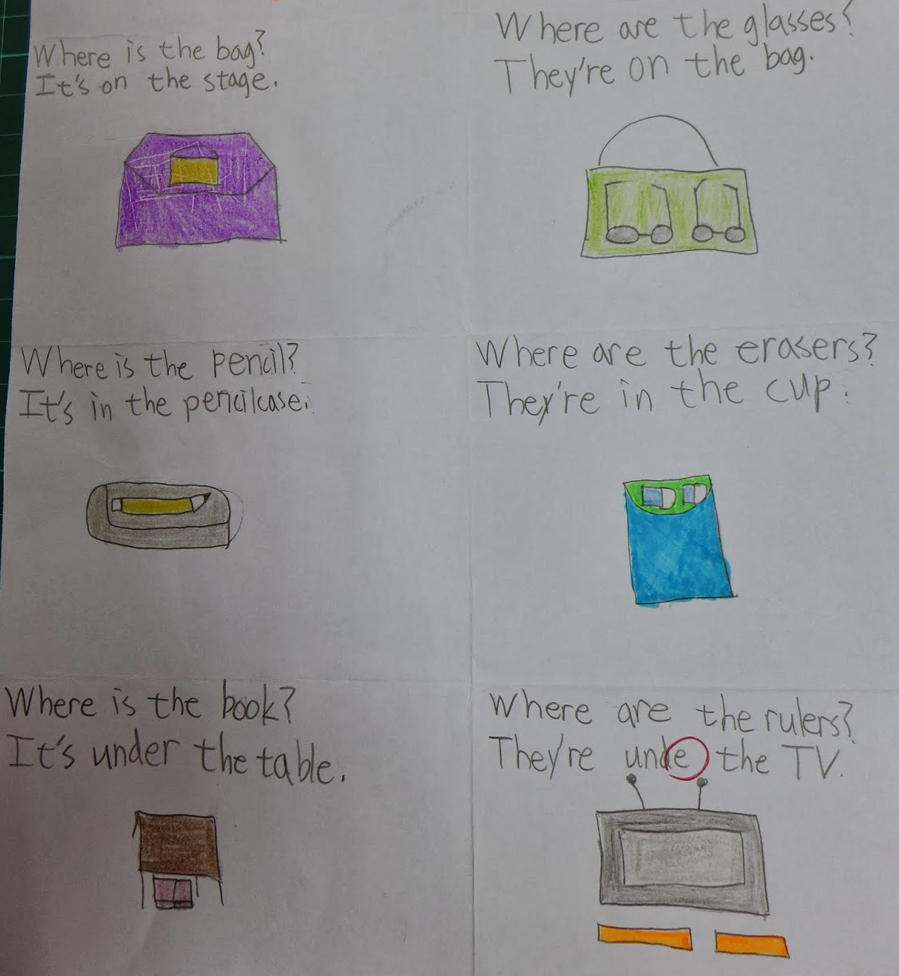

Slide 29
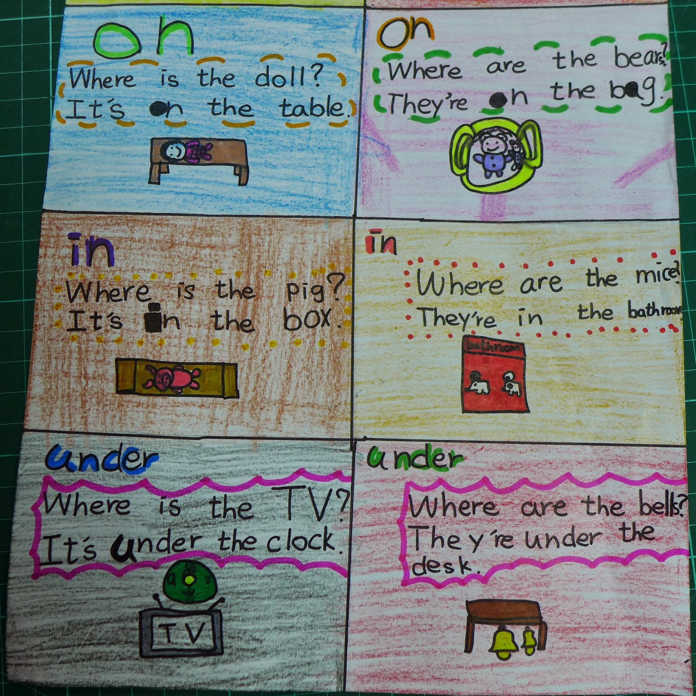

Slide 30
Preposition Book
in
on
You can take a look on your book page59.
under
next to
Class 307 01
Mandy Yeh

